Slide 1
Keyword Extraction Results
Prudhvi Raj Dachapally

Slide 2
Methods
Current Methods:
Chaining
Clustering
Clustering with Chaining Evaluation

Slide 3
Data
The results in the next slides come from the standard data. Currently, evaluation was done only on three examples.
Ground Truth:
There is no “standard” ground truth. Instead, there are keywords that were annotated by children. Each document has about 600-700 evaluations done by the students.
Two chopping methods were used to filter out unnecessary annotations.
Mean (Less words, but if there are more examples in the document, could miss some.)
Median (More words, but if the document is short comparatively, the different between candidate words and number of words to be predicted as keywords would be less.)

Slide 4
Sample
A biome is a large ecosystem that has its own kinds of plants, animals and soil. Biomes also have their own pattern of temperature and rainfall. The largest biome in the world is the taiga. The taiga is a cool forest biome. Fir and spruce trees grow almost everywhere in the taiga. These trees provide most of the world's lumber. The taiga also contains lakes and ponds that formed thousands of years ago. Taiga winters are long and cold. Along and near earth's equator are tropical rainforests. These biomes are hot and humid with plenty of rainfall. Most forests have three parts. The canopy spreads over the forest like a huge umbrella. There, the top leaves of the tallest trees receive the most light. Beneath the canopy is the understory. Here, the dense layer of leaves makes it very damp. The lower part of a forest is its floor. It is so dark on the forest floor that few kinds of plants can grow.

Slide 5
The biggest difference between animals is that some have backbones and some do not. Animals with backbones are called vertebrates. There are five groups of vertebrate animals. Frogs, toads, and salamanders are amphibians. They usually have smooth, moist skin. When they are young they breathe with gills and live in water. When they are adults, they breathe with lungs and can go on land. They lay jellylike eggs. Chickens, hawks, and robins are birds. They have wings and feathers. They use lungs to breathe. They lay hard-shelled eggs. Goldfish, trout, and sharks are fish. They are usually covered with scales. They breathe through gills. Some lay eggs, and some have live babies. Humans, whales, dogs, and monkeys are mammals. They have hair or fur during all or part of their life. They breathe with lungs. Most have live babies that are fed milk from their mothers. Snakes, turtles, and alligators are reptiles. They are covered with scales or plates. They use lungs to breathe. They lay rubbery eggs. Animals without backbones are called invertebrates. Some invertebrates, like worms and slugs, have soft bodies. Crabs, spiders, and insects are also invertebrates. They have skeletons on the outside of their bodies, called exoskeletons.

Slide 6
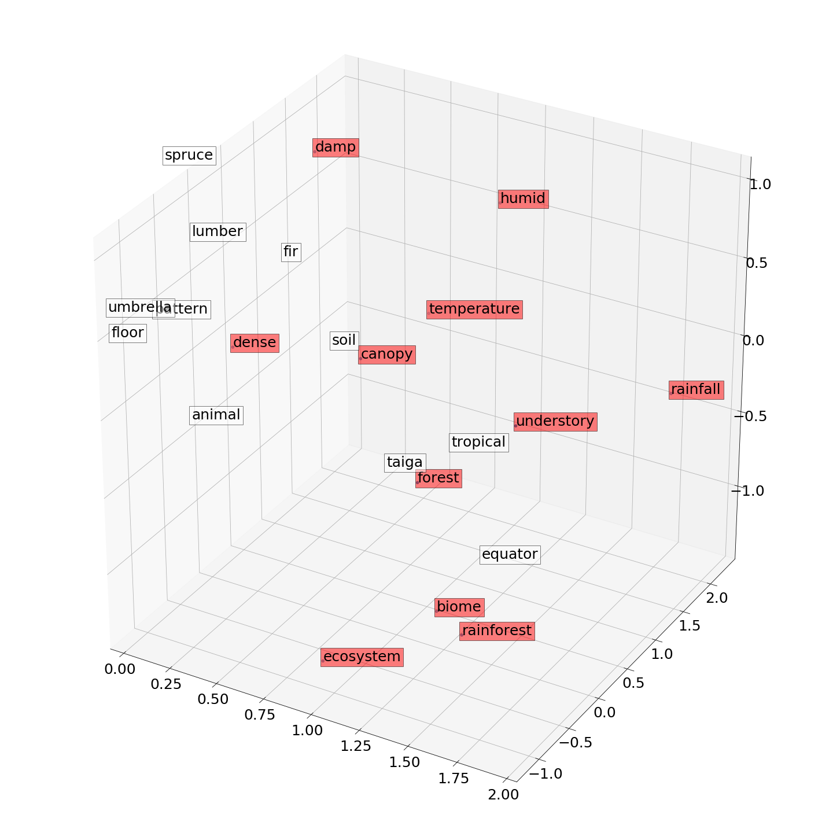
Chaining (Mean)
One Extra Allowed
Precision – 0.4783
Recall – 0.5
F-score – 0.4889
Red – hits
White – misses
Start-word: temperature

Slide 7
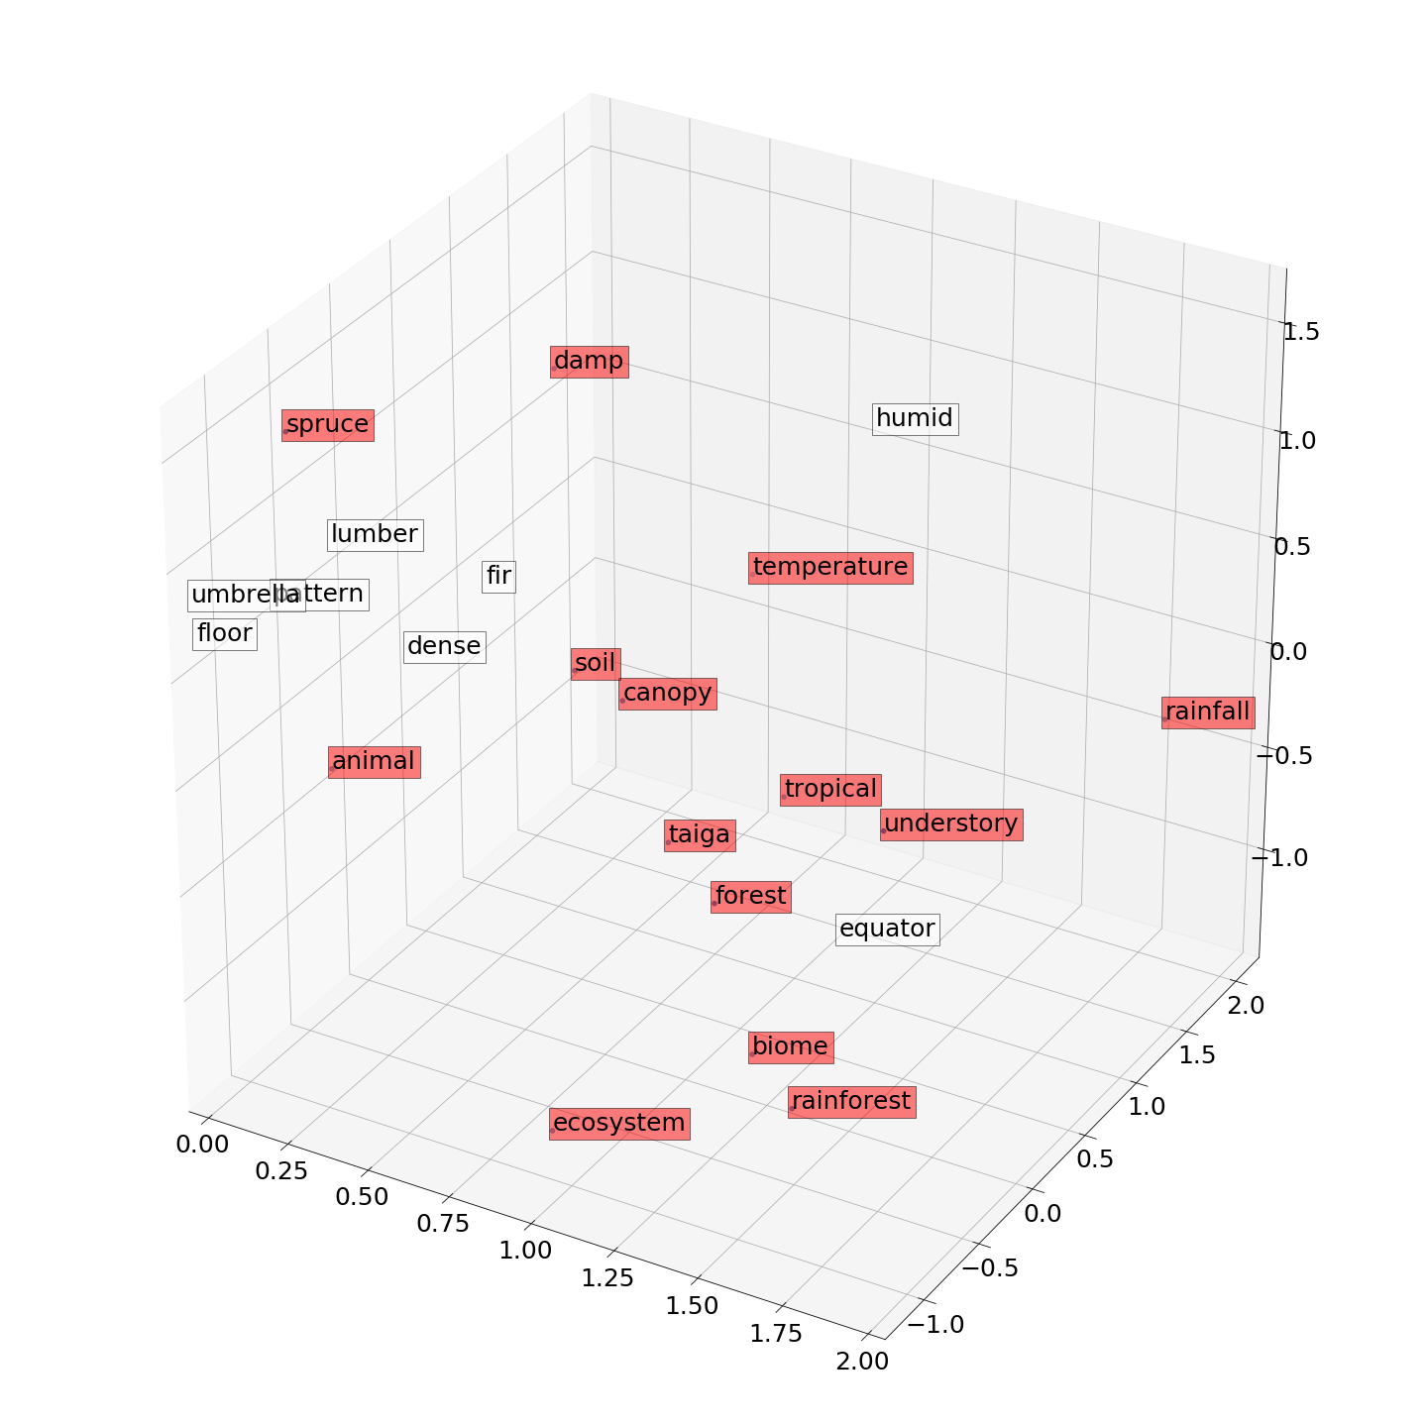
Clustering (Mean)
One Word Extra
Precision – 0.6956
Recall – 0.7273
F-score – 0.7111
Start-word: canopy

Slide 8
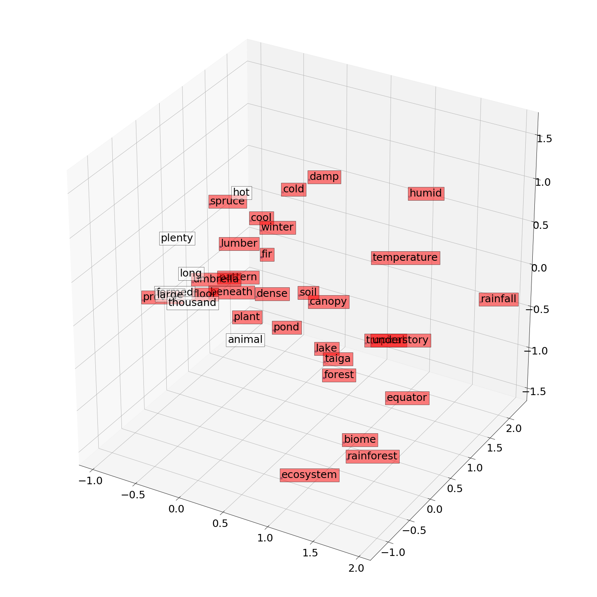
Clustering (Median)
One Extra Allowed
Precision – 0.7297
Recall – 0.8056
F-score – 0.7397
Start-word: temperature

Slide 9
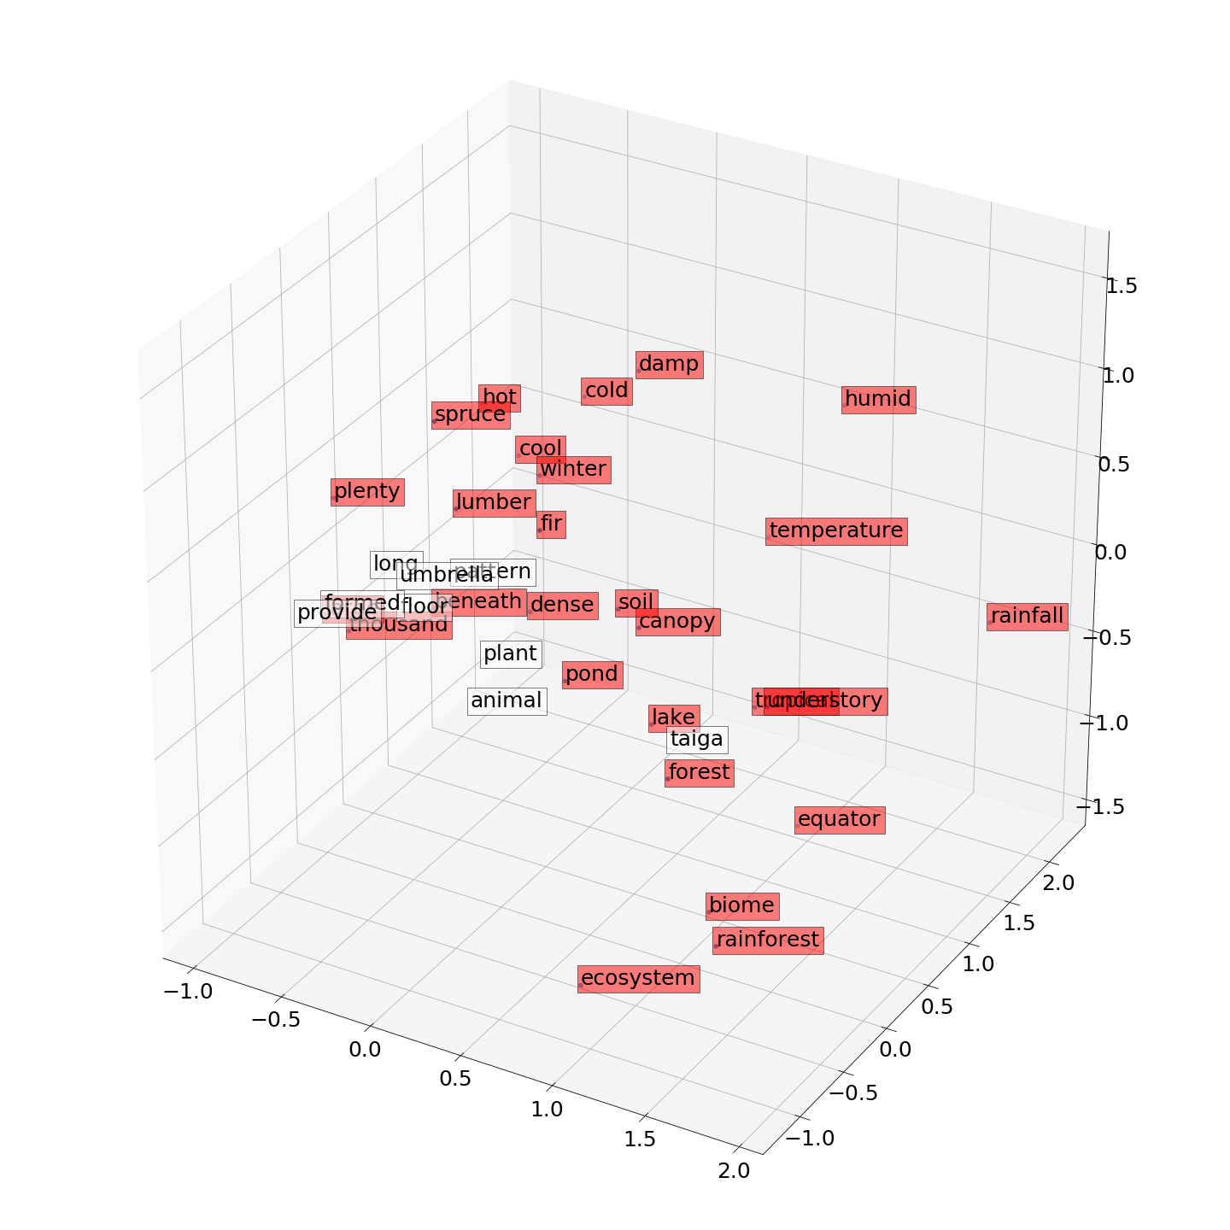
Chaining (Median)
One Word Extra
Precision – 0.7839
Recall – 0.8056
F-score – 0.7945
Start-word: Canopy

Slide 10
Precision/Recall Scores for Mean Mode

Slide 11
Precision/Recall Scores for Median Mode

Slide 12
Program Execution
The program takes eight command line arguments
Argument 1: Word-vector file. Since we are using google news vectors, the file name is GoogleNews-vectors-negative300.bin
Argument 2: Document. The name of the text document where your sample is.
Argument 3: Stopwords. The name of the file where you have your stopwords stored, one per line.
Argument 4: Ground Truth. In this case, the keyword-selection.csv file with keywords annotated by students.

Slide 13
Program Execution (Contd.)
Argument 5: Mode. Options: mean (or) median
Argument 6: Method.
chain – for chaining procedure
cluster – for clustering procedure
cluster_chain – does the clustering first, and choses the best using chaining evaluation
Argument 7: Visualization. Options: predictions (or) hits.
Argument 8: Name to the same visualization above.

Slide 14
Example
For extracting keywords using chaining method with mean as the ground truth selection mode.
python test.py GoogleNews-vectors-negative300.bin animal_groups.txt stopwords_en.txt Keyword-Selection.csv mean chain hits store.png

Slide 15
Next
Another method for cluster selection
Chaining with previous words into consideration.
Finding what makes a cluster great.
Baseline – IDF scores
TextRank based method with word2vec.
Try to find the threshold and the number of keywords in a supervised way.

